Slide 1

Youtube video comments analyzer
Shira & Daniel
29/09/2022
Data Engineer course March 2022

Slide 2

Agenda
The purpose of the project
Project architecture
Live demo
Python packages
Limitations and future features

Slide 3

The purpose of the analyzer
Perform sentiment analysis (positive, negative)
Analyze emotions out of comments
Perform descriptive statistics on video comments
Allow users to get insights out of the comment thread

Slide 4
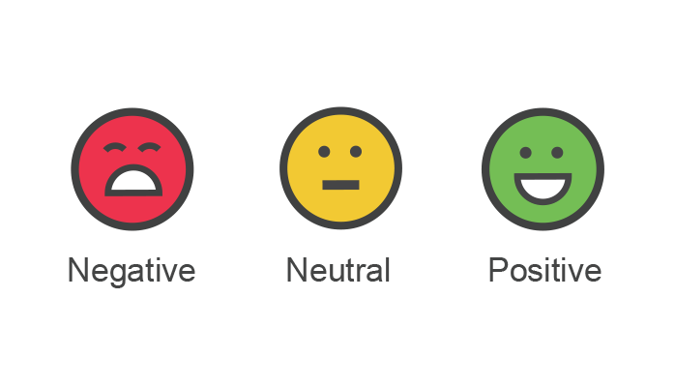






Project architecture
Youtube v3 API
Text Cleaning
Language Detection
Sentiment Analysis
with VADER
Publish findings on Streamlit web app
Emotions analysis with OneAI API

Slide 5

Live Demo

Slide 6

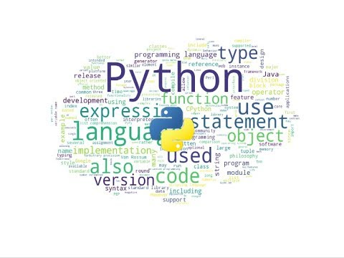


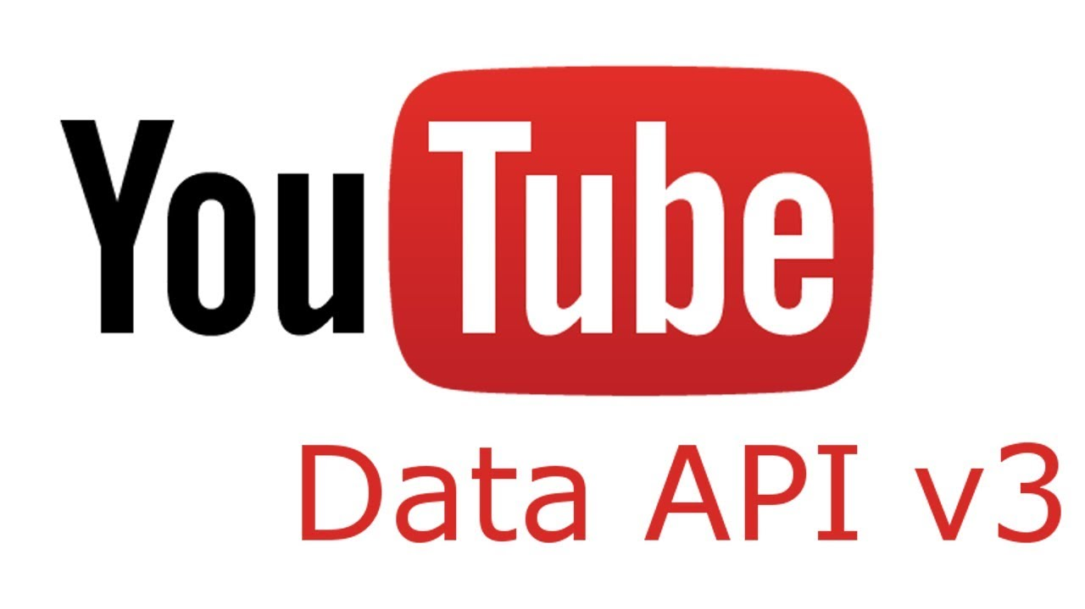
Unfamiliar Python Packages in the project
NLTK
POLYGLOT
STREAMLIT
GOOGLEAPICLIENT
ISO639, ISODATE
WORDCLOUD
SEABORN
EMOJI

Slide 7

Limitations and future features
Grammar correction functions (enhance sentiment and language detection)
Perform whole youtube channel analysis
Filter comments based on dates
Sentiment analysis is not perfect: star wars = wars is negative, slang ‘killing it’, cynicism
Publish the youtube comment analyzer app

Slide 8

Thank you for listening

